Slide 1


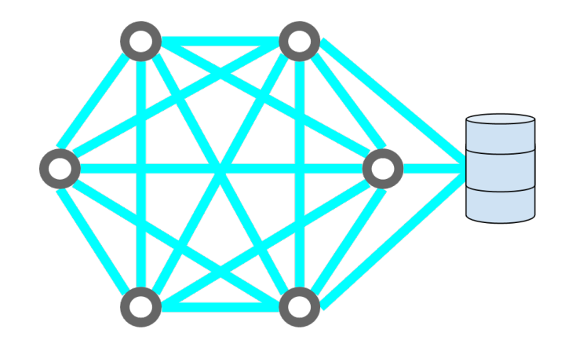
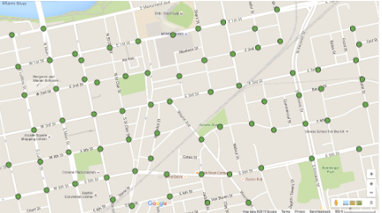
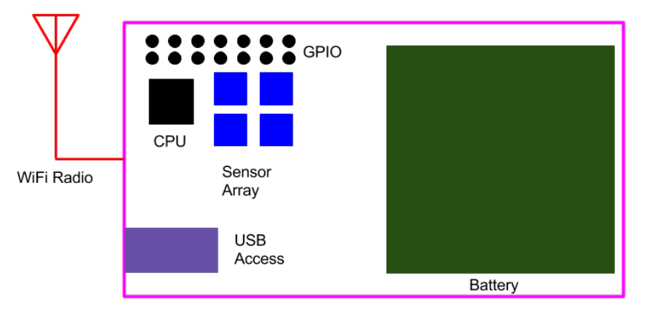
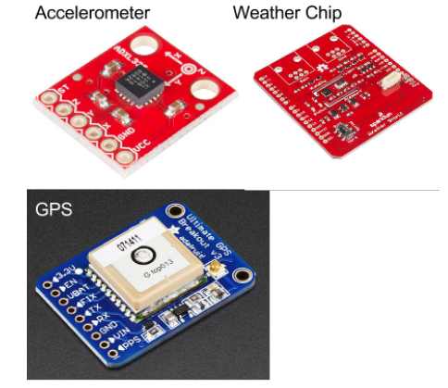
LEAN – Local Emergency Area Network
Justin Scothorn – Justin.Scothorn@gmail.com , Jeremy Van Eps – vaneps.2@wright.edu , Jorge Sosa Huapaya – sosahuapaya.2@wright.edu , Robert Cline – cline.48@wright.edu
Abstract
Design
Implementation
Future Goals
Project LEAN proposes to create deployable environmentally aware hardened Wi-Fi repeaters, with a centralized server to provide a local emergency area network (LEAN), that can dynamically fit the range of the incident location and will provide a secure, stable connection point for ICS responders to communicate and use their tools to better achieve their goals.
Lean uses a Raspberry Pi to form the base of the pods used in the network. The Pis allow for the addition of the sensor package and serve as a router. The Babel routing protocol is used to handle traffic control.
The centralized server stores information about the geography of the network and looks for any inconsistancies in the sensor data sent from the pods.
All of the scripts to handle sensor inquiries, data transmission, and database queries are written in Python. The database is built on the MySQL platform.
Problem
Fig 1: Mesh Network Overview of LEAN
Fig 4: Pod Mapping Visualization
Communication is imperative to ensure safety so ICS personnel can perform duties and have proper communication.
Communication technologies are insufficient during ICS events, they can be overloaded or damaged.
Security of sensitive information across communication platforms is very important.
Determining a damaged network node is difficult, we solve this making our pods to be environmentally aware.
Testing
Fig 2: Pod Design Insides
Tell us about your testing plan and show us the results of at least one major test
Being passed. Note that you should have ALL your test results with you at the
Presentation and be ready to discuss them if an audience member asks.
Acknowledgements
A special thanks to Dr. Gallagher, Dr. Garber, Dr. Wischgoll, Mrs. Brandy Foster and Dr. Rigling for their outstanding support through this project.
Fig 3: Sensor Components

